Slide 1
Public transportation optimization

Slide 2
OBJECTIVE
In the context of public transportation optimization, the integration of Internet of Things (IoT) sensors in vehicles presents a transformative solution. IoT sensors, strategically embedded in buses, trains, and other transit vehicles, enable real-time monitoring of ridership, vehicle locations, and predictive arrival times. This abstract explores the implementation of IoT sensors as a means to enhance public transit services. The data collected from these sensors can be made available to the public via digital platforms, providing passengers with valuable information to plan their journeys more effectively. This technology-driven approach not only improves the efficiency of public transportation but also contributes to a more sustainable and passenger-centric urban mobility ecosystem. The abstract emphasizes the importance of data transparency and accessibility in shaping the future of public transit services.

Slide 3
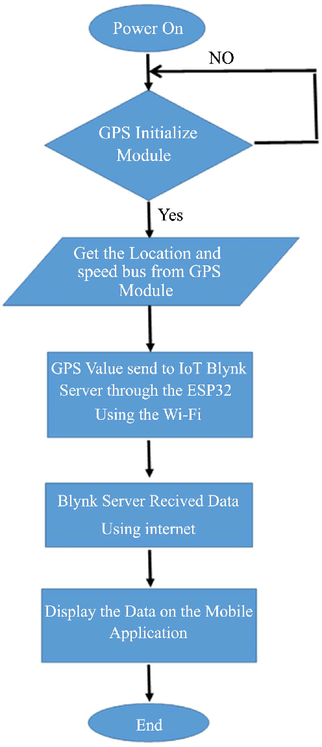
BLOCK DIAGRAM:

Slide 4
Optimizing public transportation systems is essential for improving urban mobility, reducing congestion, and promoting sustainable transportation options. Here are several key strategies and technologies that can be used to optimize public transportation:
Data Analytics and Predictive Modeling:
Collect and analyze data on passenger demand, traffic patterns, and service usage.
Use predictive modeling to anticipate future demand and adjust service accordingly.
Implement real-time tracking and monitoring systems to respond to changing conditions.
Route Planning and Scheduling:
Optimize bus and train routes to minimize travel times and maximize coverage.
Adjust schedules to align with peak demand times.
Implement dynamic scheduling to adapt to changing conditions.
Fare Integration and Pricing:
Implement integrated fare systems that allow passengers to use multiple modes of transit with a single payment.
Offer discounts and incentives for off-peak travel to distribute demand more evenly.
Multimodal Transportation:
Promote seamless integration between various modes of public transportation, including buses, trains, trams, subways, and ferries.
Develop transportation hubs where passengers can easily transfer between modes.
Infrastructure Investments:
Invest in modern and efficient transportation infrastructure, including well-maintained roads, dedicated bus lanes, and reliable tracks.
Upgrade stations and stops to enhance passenger experience and accessibility.
Public-Private Partnerships (PPP):
Collaborate with private companies to provide innovative transportation solutions, such as ride-sharing or bike-sharing programs.
Leverage private investment to fund infrastructure improvements.
Technological Advancements:
Implement smart ticketing systems, contactless payment options, and mobile apps for purchasing tickets and planning routes.
Use GPS and sensor technology to track vehicles and provide real-time information to passengers.
Energy Efficiency and Sustainability:
Transition to cleaner and more energy-efficient transportation options, such as electric buses and trains.
Promote the use of bicycles, pedestrian pathways, and green transportation alternatives.
Demand Management and Congestion Pricing:
Implement congestion pricing in heavily congested areas to reduce traffic and encourage the use of public transportation.
Encourage telecommuting and flexible work hours to reduce peak-hour congestion.
Community Engagement and Education:
Engage with the community to gather feedback and understand their transportation needs.
Educate the public about the benefits of public transportation and promote its use.
Accessibility and Inclusivity:
Ensure that public transportation is accessible to people with disabilities and the elderly.
Provide services that address the needs of underserved communities.
Safety and Security:
Enhance safety measures and security on public transportation systems to build trust among passengers.
Utilize surveillance cameras, emergency communication systems, and personnel training.

Slide 5
INTEGRATION APPROACH:
Planning in public transportation is traditionally done in a sequential process: After the network design process, the lines and their frequencies are planned. When these are fixed, a timetable is determined and based on the timetable, the vehicle and crew schedules are optimized.

Slide 6
CONCLUTION:
In conclusion, public transportation is a cornerstone of sustainable urban development. It is instrumental in promoting economic growth, environmental sustainability, and social equity.

